Slide 1
Brief introduction to R and R Studio
Dr Ana Morales-Gomez
Research Associate
UK Data Service
Introduction to analysing data about crime using R
Manchester
4-5 February 2020

Slide 2
Overview
Introduction
What is R and R Studio?
How to get R and R Studio? (downloading and installing)
R Studio environment
Getting Started
Data types and Structures
Using data
Notes:
Introduction
What is R and R Studio?
How to get R and R Studio? (downloading and installing)
R Studio environment
Scripts
Codes
Getting Started
working directory
projects
installing packages
Data types and structures
vectors
data frame
factors
Using data
Where I’ll show you how to import data into R.

Slide 3


Introduction: What are R and R Studio
R is a statistical programming language
Open source
Free
Available for Windows, Macintosh, and Linux.
Huge community of users and developers
Scripting language, i.e. uses code
Integrated Development Environment or IDE
All of R goodies, plus
User friendly interface
Need R installed
Notes:
Definition of R
Open source… people created their own programmes
Huge community… that also means lot of help
Scripting language… there are also other integrated development environment that uses click and point, but it is really cumbersome for some tasks and we are not covering this here
As I said, R needs codes to produce the task we ask, with this code you can write down your analysis, create functions, make use of other people’s functions, such as the one available in R packages, create maps and many more.
R Studio
User friendly interface for R that keep all the capabilities of R in a nice organise screen. so users can clearly view graphs, data tables, R code, and output all at the same time.
Also free and open source, it is also available on Windows, Mac and Linux
However, in order to use R Studio you need to have R installed first
You’ll almost never need to use R directly in this course - R is much harder to use than anything professionals interact with. Most practitioners use what’s known as an IDE - an Integrated Development Environment. There’s a lot of choices of IDEs for R, but RStudio is the best one.

Slide 4
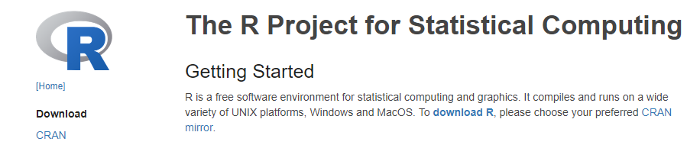
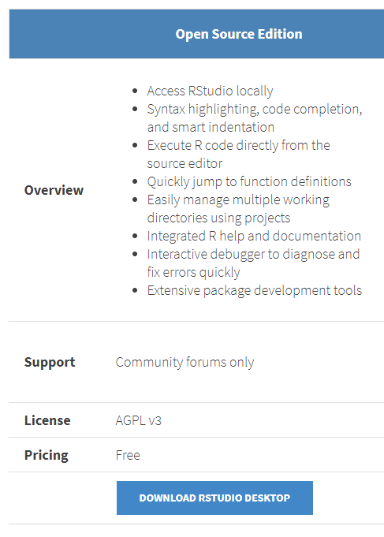

Download and installing
https://www.r-project.org/
https://www.rstudio.com/products/rstudio/download/
Notes:
You need R and R Studio installed in your machine to be able to use R studio.

Slide 5
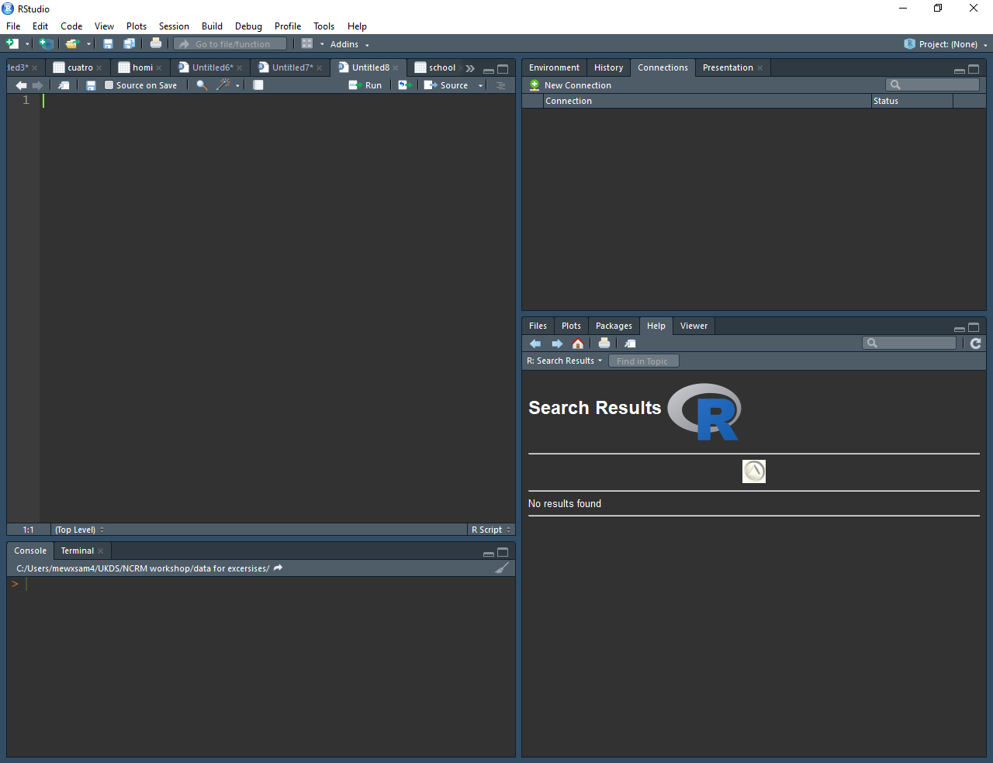
R Studio Interface
This is the script editor
This is the R environment explorer
This is the R console
This is the file explorer
Notes:
RStudio is the interface we use to work with R. It has a number of features to make it easier for us to work with R -
When you open up RStudio you’ll see four panels, each of which plays an important role in RStudio
https://r4crim.com/introduction-to-r-and-rstudio.html

Slide 6
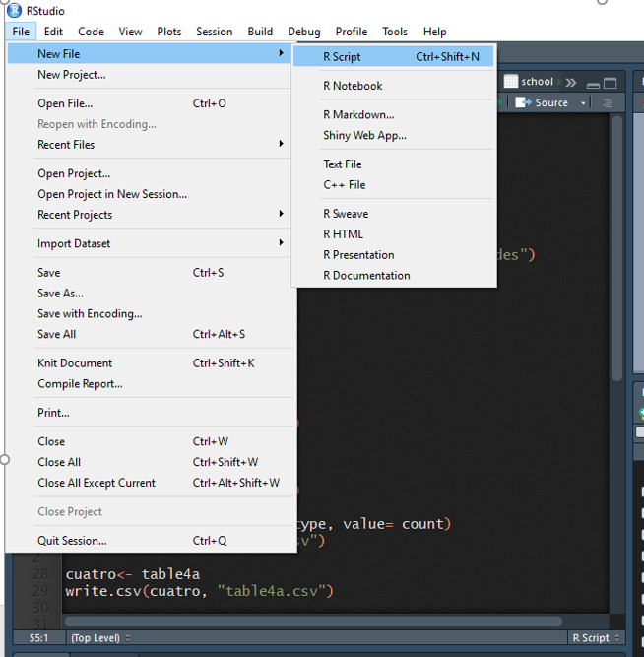
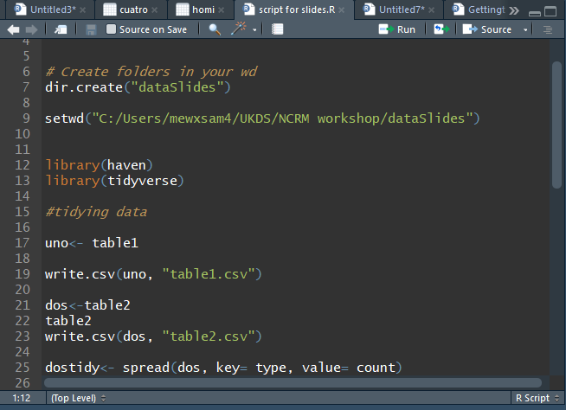
Getting started with R: Scripts
Scripts are used to save our work and analyses
Can be stored as R script or Notepad
Can be opened again in later sessions
Can be copied and modified
Can be shared
Notes:
An R Script is essentially a text file (similar to a Word document) where you write code. It is a good practice to always do your R code on a script, as it would help to keep track of what you have done and can also be re-used.
You creates a new script by clicking on file, R script or
You can also create other outputs such as markdown files and presentations
To open a saved script, just click on ‘Open file’ and search for it

Slide 7
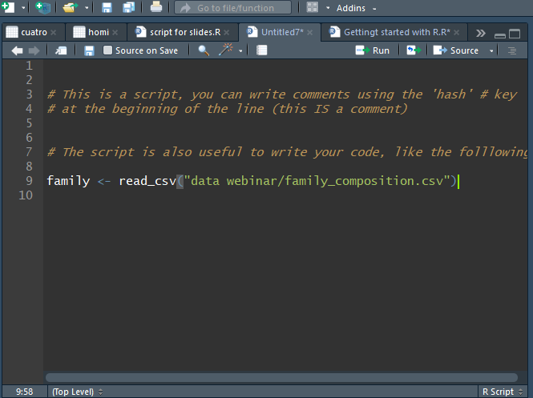
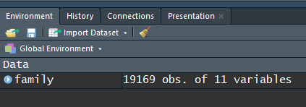
Scripts
You can select a code and press ‘Run’
Or, click/select on the line of the code and press:
Ctrl + Enter (windows)
Command+Alt+R (Mac)
Notes:
To run code in an R Script just click on a line of code or highlight several lines and click the “Run” button on the top right of the Source panel.
Or you can click or select the line of codes you want run and press ctrl+enter
You can add comments to your script in which you briefly explain what you are doing, you can also add some comments indicating whether the code worked or not for what you wanted
You’ll see the lines of the code run in the Console and any output, (if your code has an output) will be shown there too. In this case the code is importing a csv file into R, so we won’t see the output in the console, but in will appear as a new object of the environment in the right side of the screen.

Slide 8
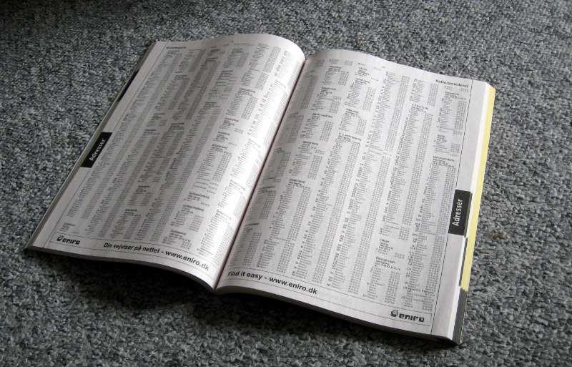
Working directory…
Tells R where our data is saved in our PC, laptops, external drive.
Tells R where to save our new analyses and figures
Code to set the working directory:
> setwd(“your/folder/path”)
To check where the working directory (wd) is:
> getwd()
OR…
Notes:
Let’s talk about the working directory. There is nothing fancy about this, it is just the place where our data is stored, or where we want our data to be stored.
So, it is basically a folder in usually in your computer where the data that we need to analyse is saved.
We need to tell R specifically where this folder is so we can then import the data for analysis. Besides, anything that we do will be saved in this directory,
How do we tell R what our working directory is, well, we can use the function setwd with the path to our folder between brakets.
Or

Slide 9
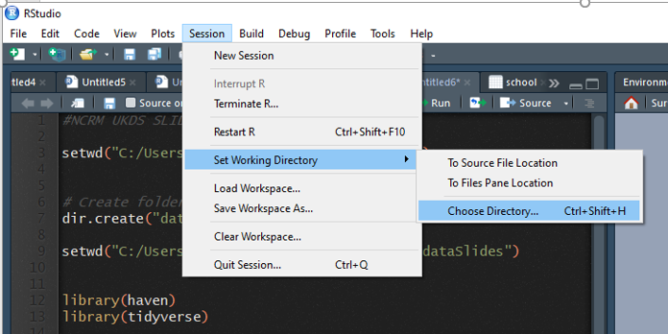
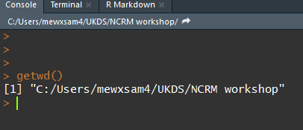
Working directory
Notes:
alternatively, if you are not sure, there is an alternative and easy way. You can set the working directory from the session menu of R studio, then choose the appropriate folder
R studio will set the working directory to your preferred location and display the set working directory function on the console, so you can save the code for a next time

Slide 10

Packages
Collection of R functions, compiled in a defined format
Set of basic pre-installed operations
R needs packages to do certain tasks
haven: For importing datasets in other formats (SPSS, Stata, SAS).
ggplot2: For producing graphs
tmap: For producing maps
Code
> install.packages(“haven")
> install.packages(“haven“, “ggplot2”)
OR…
Notes:
Packages are collections of R functions, data, and compiled code in a well-defined format.
An R package is simply a bunch of data, from functions, to help menus, to vignettes (examples), stored in one neat package.
The directory where packages are stored is called the library.
R comes with a standard set of packages already installed
Others are available for download and installation, that is for example the package haven, to import data in specific formats, ggplot2 for graphs, tmap for mapping and much more
Once the package is installed, they have to be loaded into the session to be used.
Here is the code for installing packages, you can install one or several at the same time, as you can see in the two code example.
Alternative

Slide 11
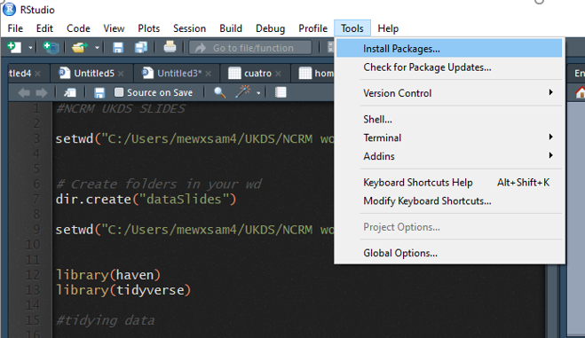
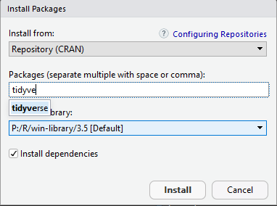
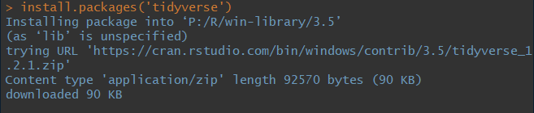
Installing packages
Notes:
You can ask r studio to install it for you from the ‘tools’ menu, then you search for the package and R studio will installed and send the code used to the console, so you can the code.
If you installed the package by clicking on the tabs, you can see that the code is being copied in the console, this is really important, as you can also learn the code, an next time, you can as R to install a package by coding.
If you are working on your own machines and don’t have tidyverse installed you will see a screen similar to this one, it can take some time as tidyverse is a collection of several packages so there are load to install. You can also install each package by itself.

Slide 12
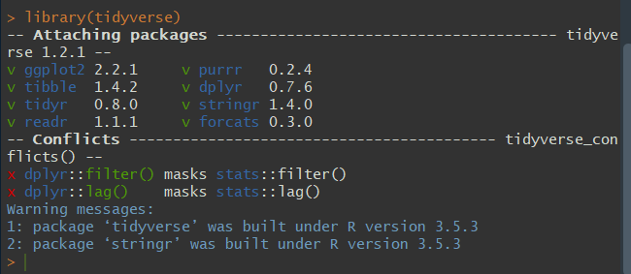
Loading packages
Each package needs to be loaded every time you start a new R session
Only load the package that you need to use
Can be done at any time
Indicate in the script the packages used
Notes:
R need to load the packages in order to use them. Here you can see that I have loaded the dataset into the session. As I mentioned before, tydiverse is composed by several individual packages, that you can install at a stand alone package

Slide 13
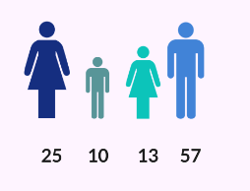

Data types and data Structures
Data types
character
numeric (real or decimal)
integer
logical
Structures
Vectors (variables)
factors
list
matrix
data frame

Slide 14
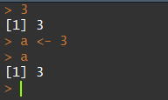
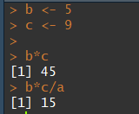
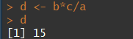
Variables
Variables are objects in R that store values;
The “<-” tells R to take the number to the right of the symbol and store it in a variable whose name is given on the left.
Notes:
When you make an assignment R does not print out any information. If you want to see what value a variable has just type the name of the variable on a line and press the enter key:
This allows you to do all sorts of basic operations and save the numbers:

Slide 15
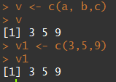
Vectors
vectors are ‘a single entity consisting of a collection of things’
a in this example is a vector of length 1
Longer vectors can be created by concatenating ‘c’ values
There are several types of vectors such as character vectors, numeric, logical, etc.
For example: The typical variable age in a dataset is a ‘vector’

Slide 16
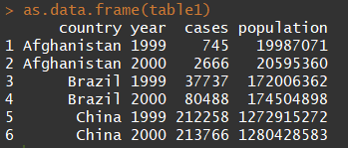
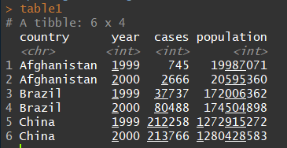
Data frames and Tibbles
Data frames are the ‘de facto’ data structure for tabular data.
Tibbles are data frames, but with some tweaks.
Designed specially to work well within the ‘tidyverse’ package
Reference: R for data science chapter 10
https://r4ds.had.co.nz/tibbles.html
Notes:
A data frame is a very important data type in R, put it simple, it is a series of rows and columns with headers indicating variable names and row numbers indicating case numbers
Tibbles, are also structures for storing tabular data.
AS you can see tibbles are a bit more informative than data frame, it immediately tell us the class of the variables. Country is a character or nominal variable, while the other variables are all integers. Tibbles also make easy to read the numbers by highlighting the thousands.
On the other hand, data frames, have a bit of a cleaner view in the console
Both type of tables are essentially the same, but tibbles are the de facto data frame type used in the tydeverse packages because it work really well with all the functions available. However, we can still use data frames and tidyverse functions.
So, why am I telling you about this two types of tabular data? Just because, data frame are the most known data structure in R and probably you are already familiar or have heard about them, however we will be using a lot of tidyverse functions during the workshop and I don’t want you to get confuse on this as it doesn’t matter what type of tabular data we use, the operation will work anyway.
I personally, I still called them data frame, and I still use both types of data structure.
If you want to learn more of tibbles and data frames, you can read chapter 10 of the book R for data Science. It is a very short chapter that offer a good description of both data structures.

Slide 17

Importing data
Get the appropriate package:
haven
foreign
readr
Use the right function:
Examples using functions from ‘haven’ and ‘readr’ package
Csv files: read_csv(“mydata.csv”)
Stata files: read_dta(“mydata.dta”)
SPSS files: read_sav(“mydata.sav”)
Give your data a name!: census<- read_dta(“mydata.dta”)
Notes:
As we learned before, we need to set our working directory to the folder where the data is.
R can analyse data on almost any format in R, but we need to make sure that R would be able to read the data. There a few packages used for importing data of different format into R, the most common ones are foreign and haven.
Importing data using foreign, will create a ‘data frame’, while using haven will create a tibble. One of the advantages of using haven is when you have a dataset into SPSS or Stata format, especially the newer ones, as it make easier working with factors or variables with labels.

Slide 18
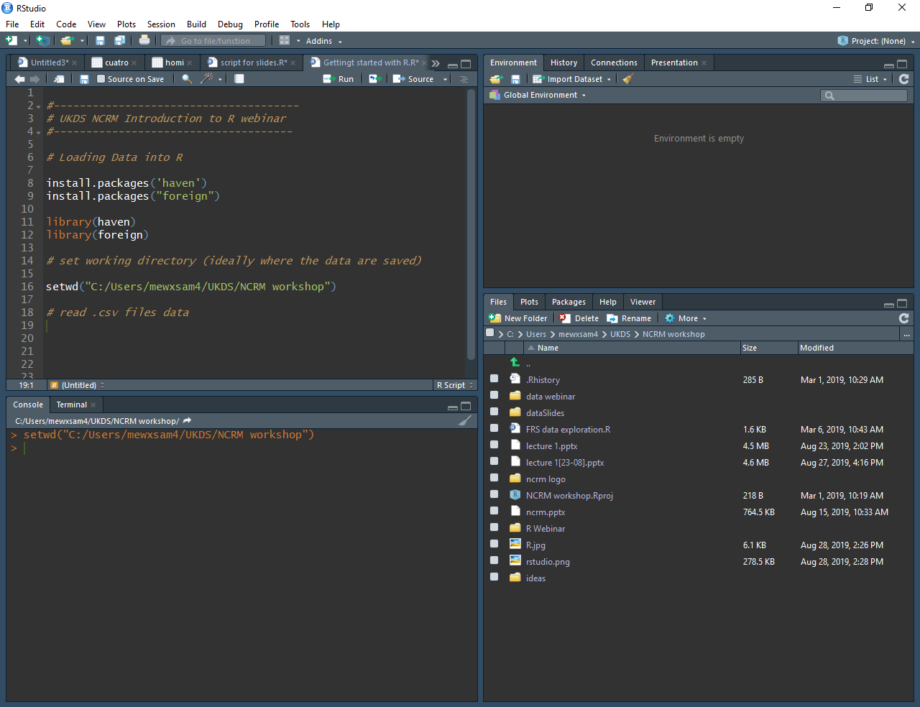
Notes:
Here you can see how the r session looks like. I’ve set the working directory to my folder of choice and you can see on the right-down screen all the folder and files that I have in my working directory. The data that I want to use are in the ‘data webinar’ folder here. I could have set my working directory specifically to the data folder, but this would imply that I would have need to change it more often, if I wanted to use files from other folders, but it is not problematic, it just a matter of preferences

Slide 19
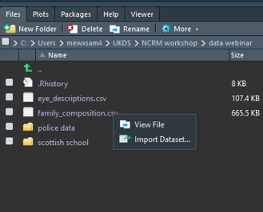
Importing data, the easy way
Double click on the folder where the data is
Click on the data we want to import: family_composition.csv
Click on ‘import dataset’…
Reference: R for data science chapter 11
https://r4ds.had.co.nz/data-import.html
Notes:
I’ll first going to show you the ‘easy’ way to import a dataset into R. This way only works if we have the tidyverse package installed and loaded. Here we focus on the file explorer window, I just double click on the folder where my data is saved and I can see that data.
If you want to learn more on how to load data into R, check chapter 11 of the book R for data Science, with good explanation and some examples.
I want to import the data ‘family composition’ into R, so I just click on it and R Studio give me two options: View file and Import dataset. You can explore the view option in your own time,
Now we are going straight to import dataset, which allows R to create the code and import the dataset for us.

Slide 20
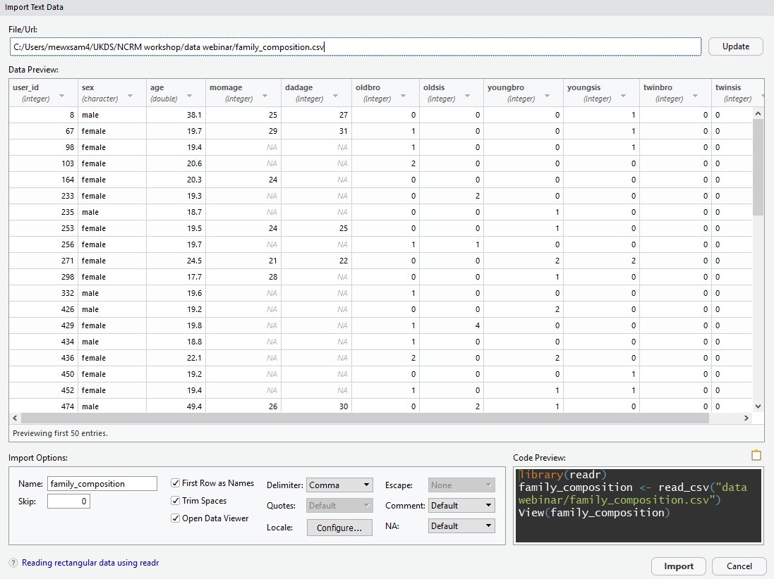
Notes:
This is the screen that popped out after I asked to import the dataset. There is a preview of how the data look like, as it is udes one of the tidyverse packages, the data will be imported as a tibble data.
Here are set of Import options, we can change the name of our data in R. The default name is the name of the file that we are importing. There are other options, but we will just leave it like this now.
On the right side, there is a code preview, which show us how the code needed to import the data, so we can learn how to it.
We can just click on ‘import’ and the data will be loaded into our R session. It may take a bit, but it will work.

Slide 21
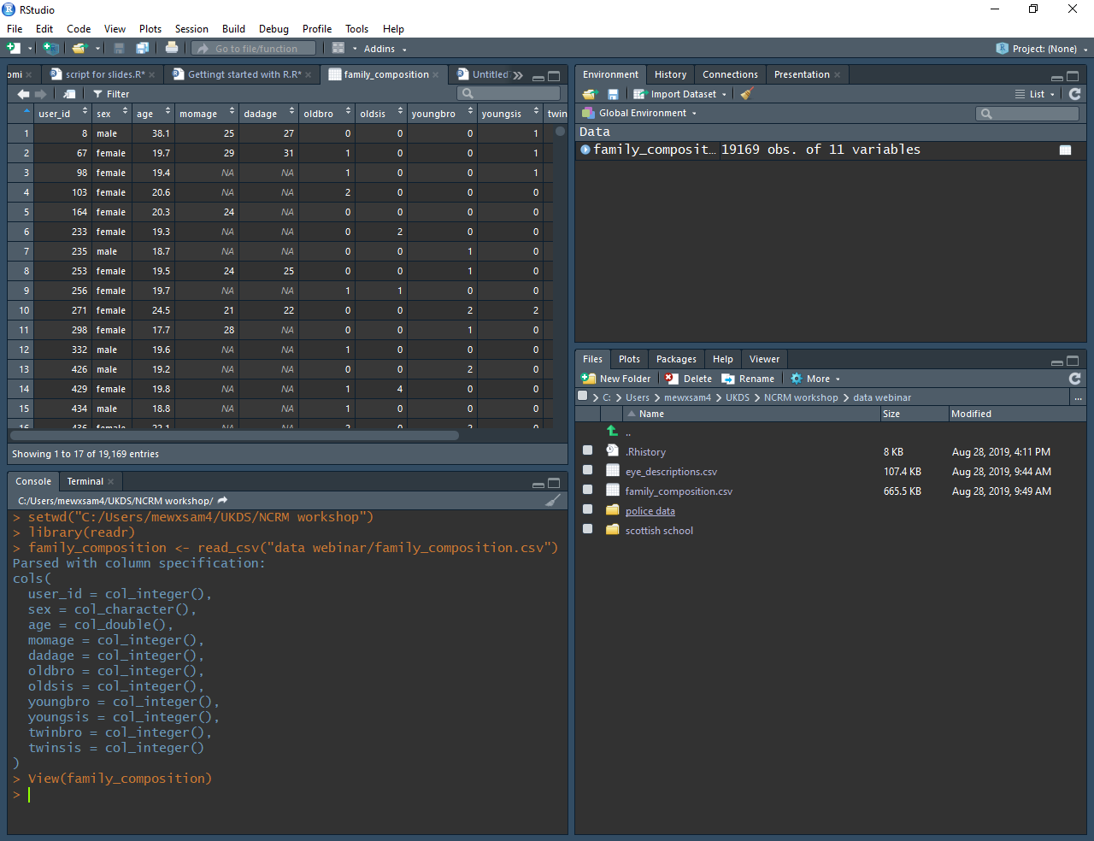
Notes:
Here is the data already imported.
We can see a preview of the data, then in the left, we have the environment window, I which we see the data frame imported it got over nineteen thousand cases and eleven variables
Then in the console, we can see the code used, we can copy and paste this code in our script, so we can repeat the process later.

Slide 22
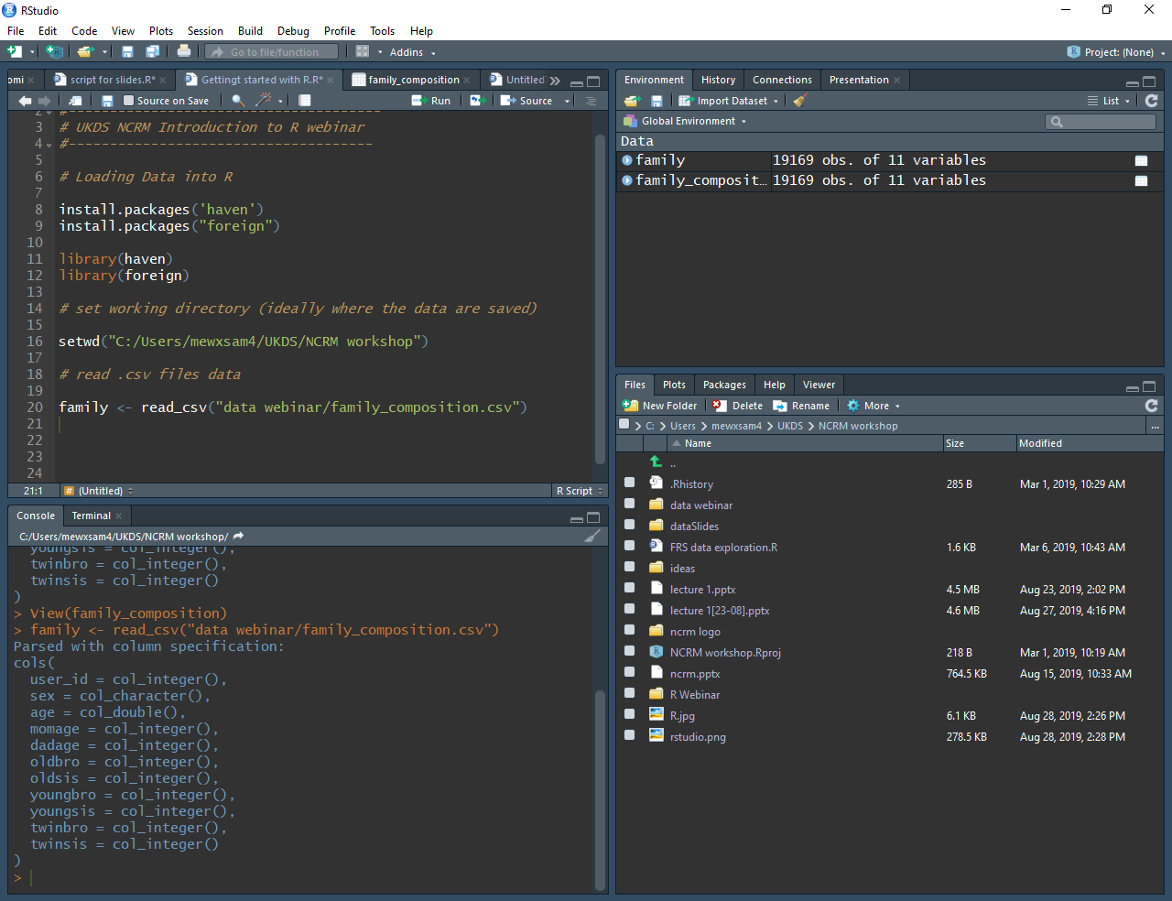
Notes:
The not that easy way, is just writing the code to import the data.
You can see I wrote the code in the script. I’ve changed the name on the data, its just called family and then pressed run (or ctrl+enter)
The data got loaded, as you can see in the global environment there are two datasets loaded, they have different names, although are the same data imported.
What I wanted to show you, is that either way of importing the data is fine, ‘the easy’ way is useful for learning, but a bit slow, with practice you would probably prefer to write the code your own.

Slide 23
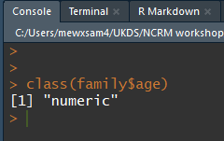
Using data in R
To perform operations on specific variables, we need to specify the data frame and the variable: class(family$age)
class(family$age)
function
dataframe
Data extractor
variable
Notes:
Ok, to perform any operation on the dataset, R has a particular way of working
We need to use specify the name of the dataframe that we are using, every time,. It seems a bit too much, but you’ll get use to it very easily.
For example, this code uses the function ‘class’ that give the type of variable, such as character, numeric and others
So, we write the function followed by a an opening bracket, then we specify the dataframe that we are using.
You can see here a dollar sign, which in R can be interpreted as ‘belong’ or something similar which is followed by the variable age which the data that we are trying to analyse.
Here, there is another example using the function ‘table’ which return a frequency table of the variable sex.

Slide 24
Recap getting started with R
First, tell R where your data is; i.e. set your working directory
Second, install/load the required package(s)
install.packages(ggplot2) library(ggplot2)
Third, Import the data
Csv files: read_csv(“mydata.csv”)
Stata files: read_dta(“mydata.dta”)
SPSS files: read_sav(“mydata.sav”)
Give your data a name!: census<- read_dta(“mydata.dta”)
Remember
R is case sensitive, be careful with spaces and capitals/lower case
Choose an informative and easy to type name for your data
You will need to write it a lot while you analyse!
Notes:
First of all, when you open R or R studio, remember to set the working directory,
Then open an script and load and install if needed, the required packages
Third, import your data, using your preferred form, coding or clicking. Remember you need to give your data a name,
Some things to consider:
R is case sensitive, so be careful with spaces and capital letters
As an advice, always choose a short, but informative name for your variables and dataframe

Slide 25

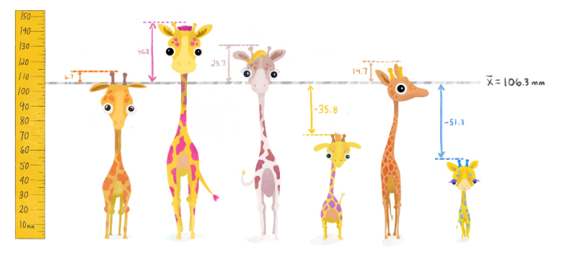
Recommended online resources
Teacup, giraffe and statistics:
A cute and interactive online introduction to R
Standard deviation

Slide 26
Where to go if you are stuck
Trial and error (actually errors... and lots of them!)
Search code online:
Wickham and Grolemund, 2016. R For Data Science. Available: https://r4ds.had.co.nz/
Quick R: http://www.statmethods.net/
http://www.ats.ucla.edu/stat/r/
http://stackoverflow.com/
https://stats.stackexchange.com/
https://github.com/trending/r
http://www.cookbook-r.com/
See also the swirl R tutorial on the web http://swirlstats.com
Or… simply google your questions
Copy code, modify it if necessary and run it
Repeat

Slide 27
Your turn

Slide 28
Ana Morales-Gomez
ana.morales@manchester.ac.uk
To follow UK Data Service on Twitter:
@UKDataService

